Slide 1
Transmission Electron Microscopy
Historical motivation, techniques and applications

Slide 2
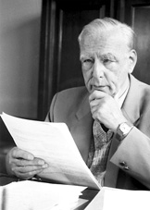
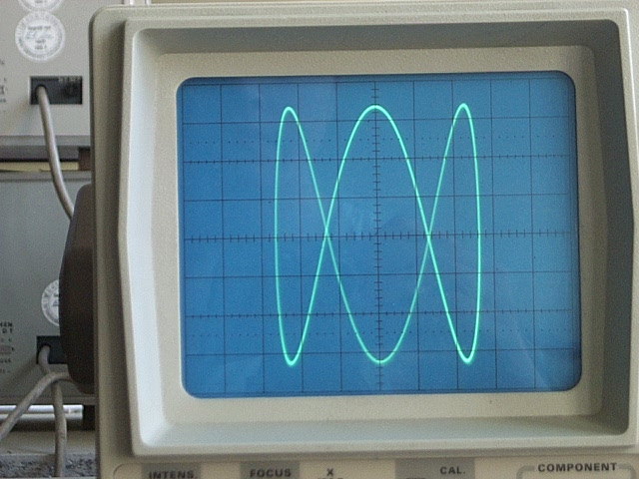
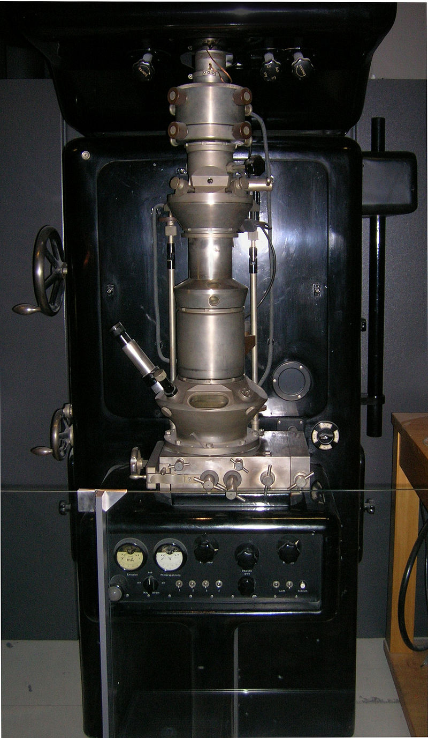
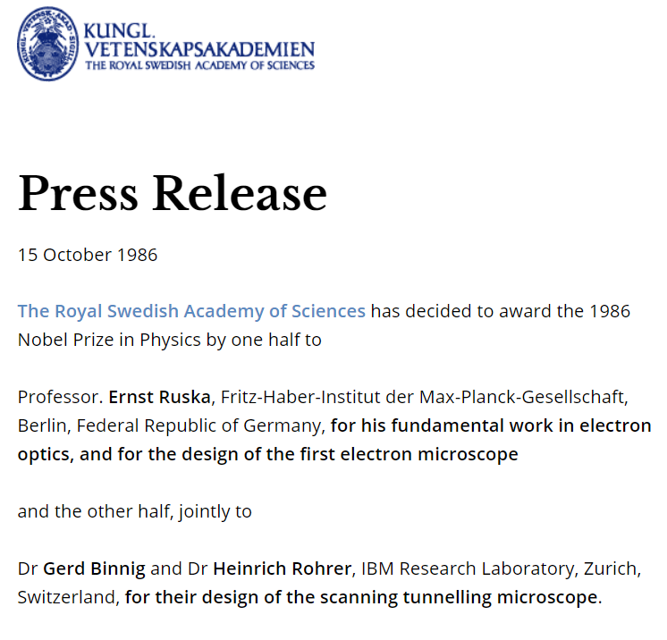
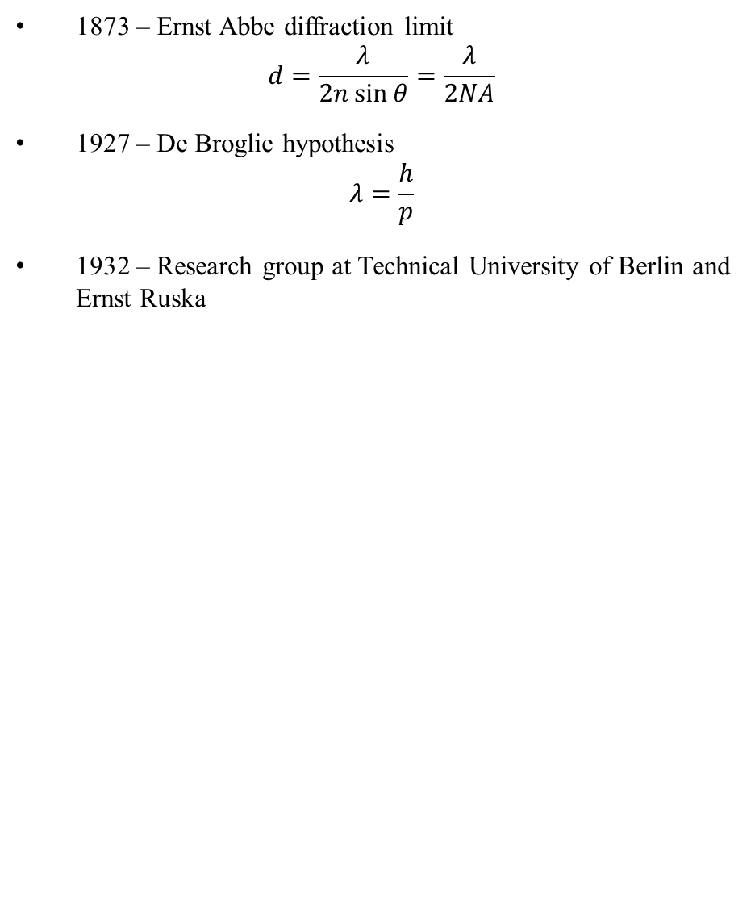
Historical motivation
1873 – Ernst Abbe diffraction limit $d=\frac{λ}{2n\sin{θ}}=\frac{λ}{2NA}$
1927 – De Broglie hypothesis $λ=\frac{h}{p}$
1932 – Research group at Technical University of Berlin and Ernst Ruska

Slide 3
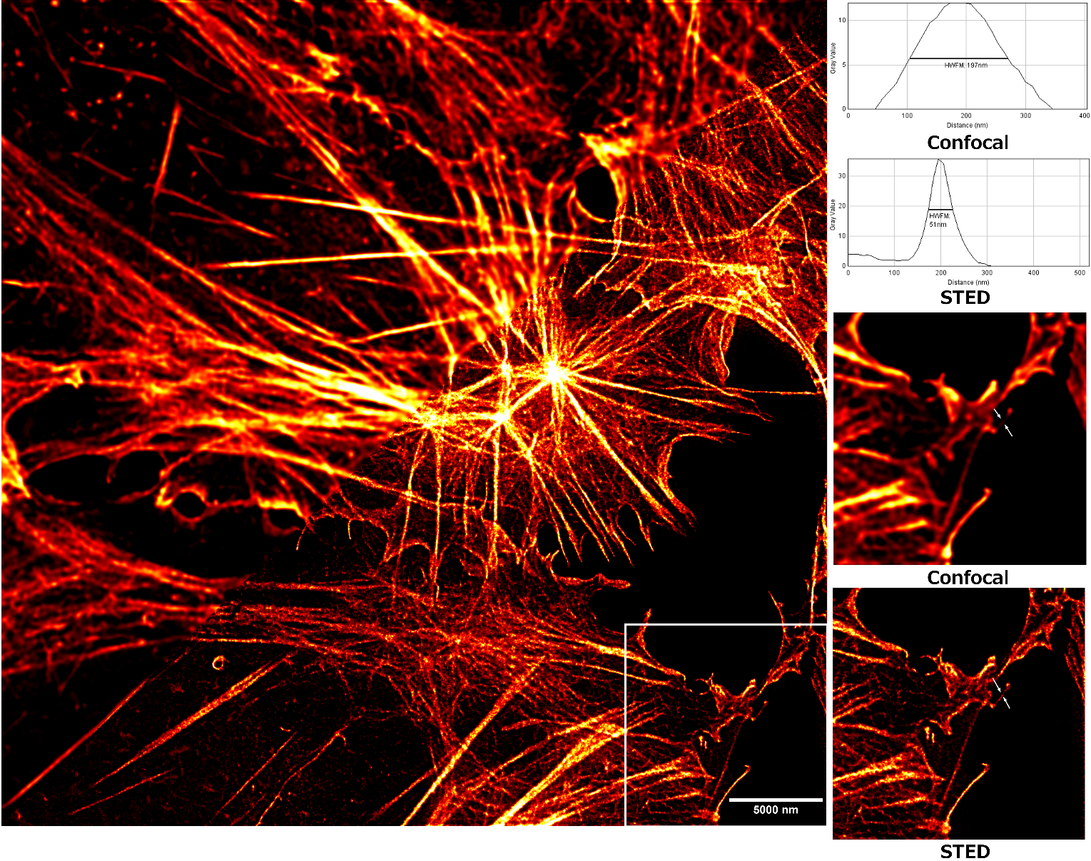
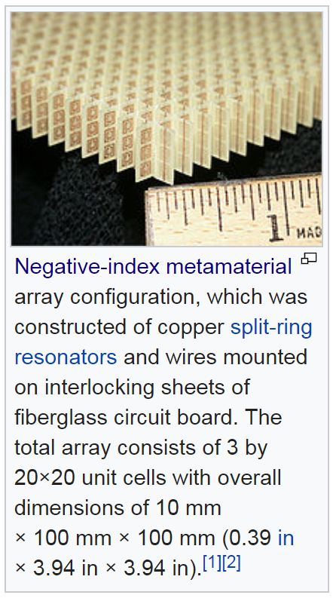
Other ways to cheat the diffraction limit
Far field techniques
Near field techniques
A figure showing the resolution improvement between traditional confocal microscopy and stimulated emission depletion (STED) microscopy. Cells were stained with 647-phalloidin to show actin filaments and the images were taken on a Leica SP5 2P STED microscope. FWHM - Full width at half maximum

Slide 4
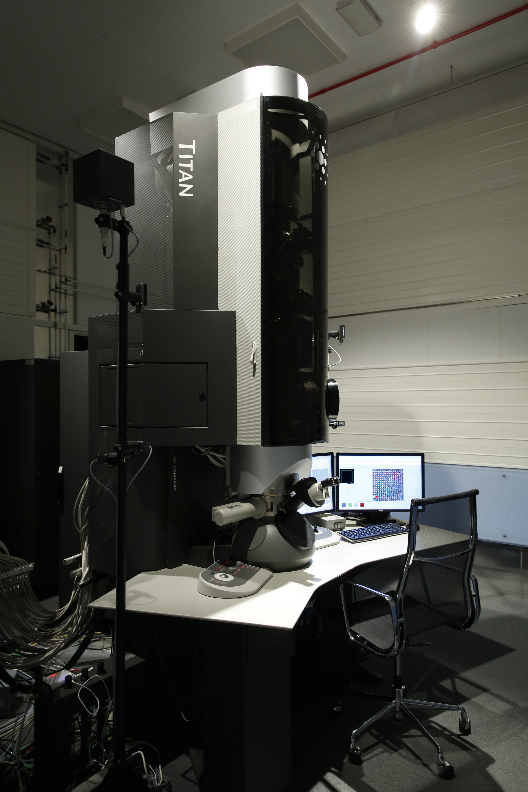
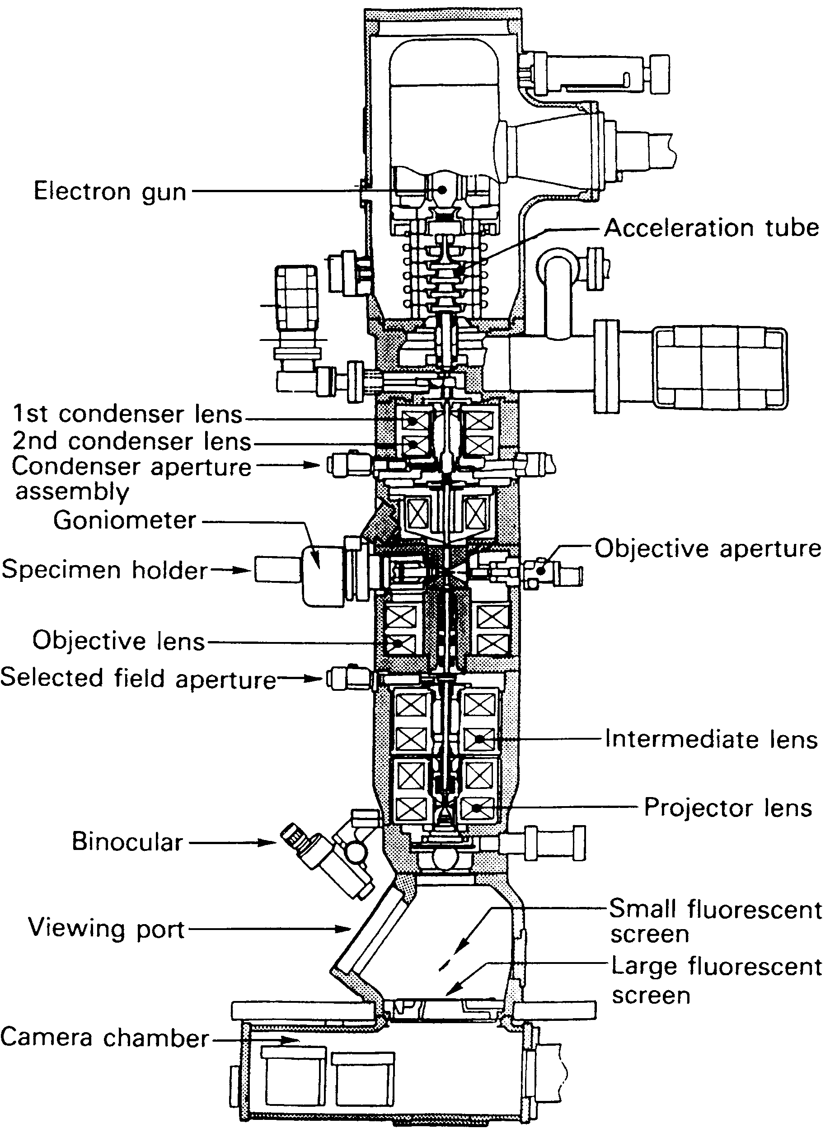

Slide 5
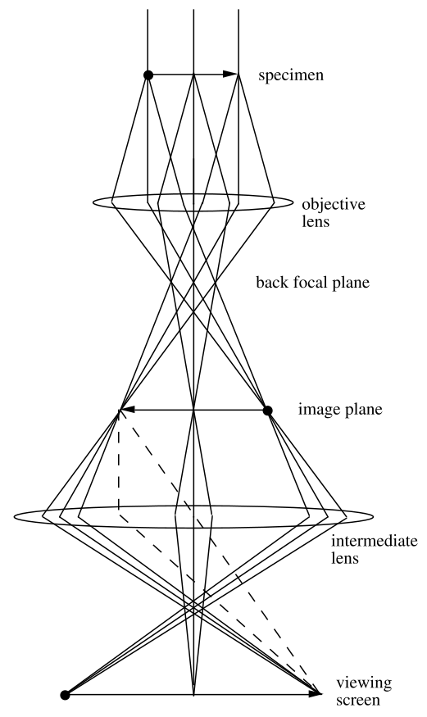
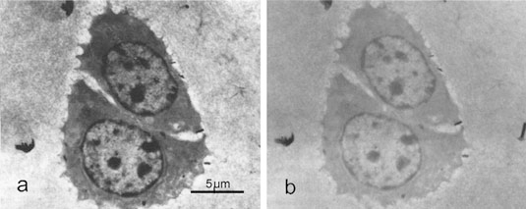
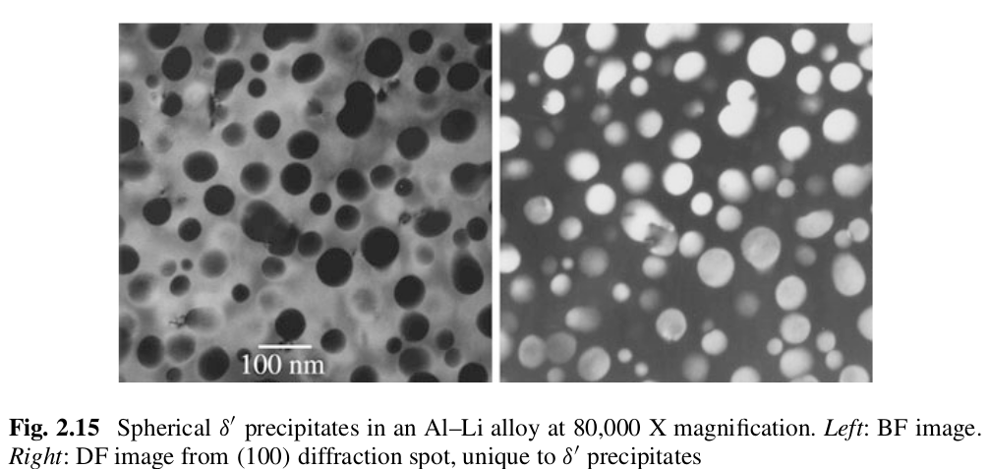
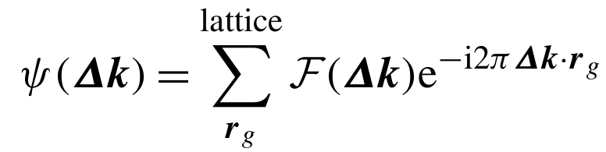
Mass-thickness contrast
Diffraction contrast
Animal cell stained with Osmium, targeting chromatin

Slide 6
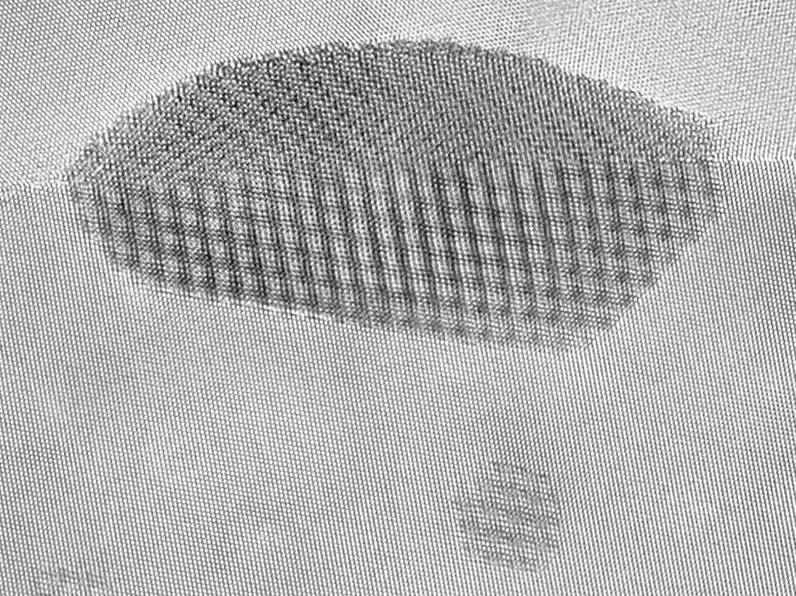
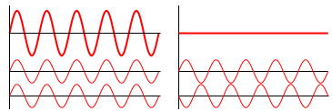
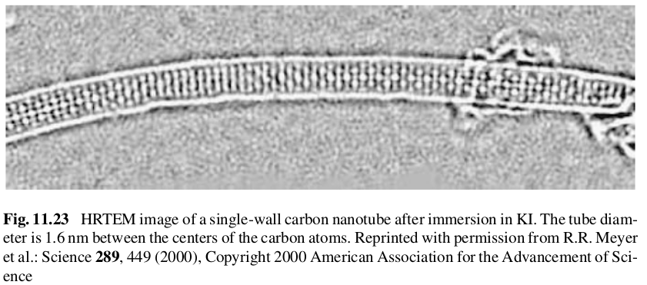
Phase contrast and HRTEM
HRTEM image of lead crystal between two crystals of aluminium

Slide 7
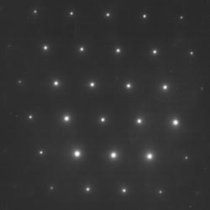
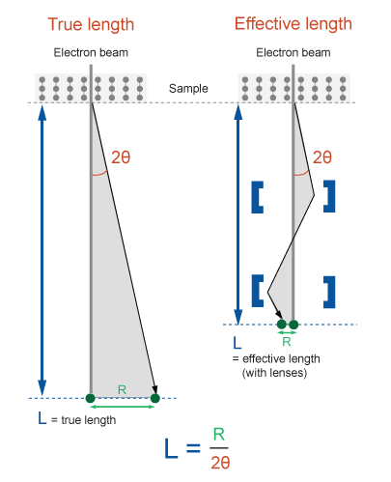
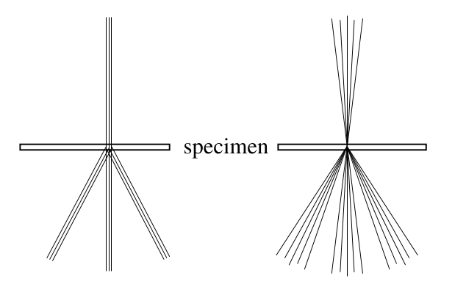
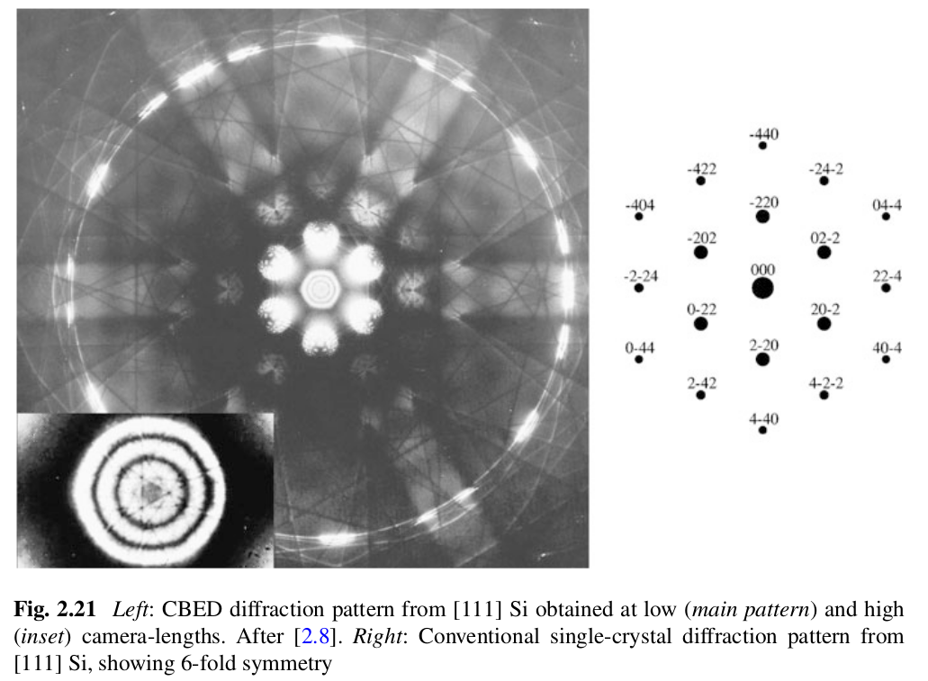
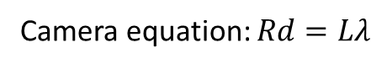
Diffraction
Camera equation: $Rd=Lλ$
SAD
CBED

Slide 8
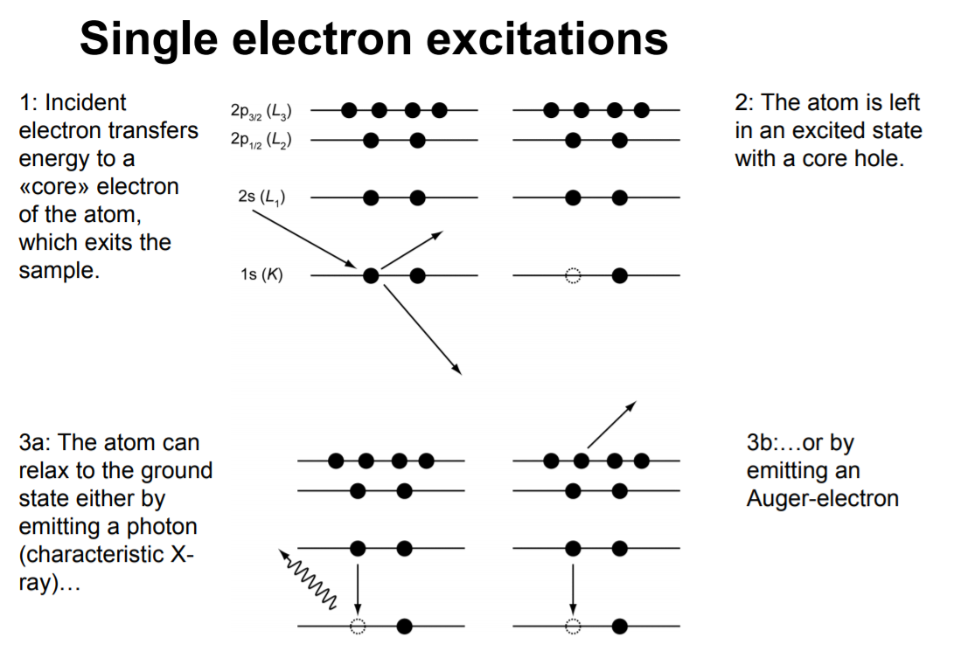

Slide 9
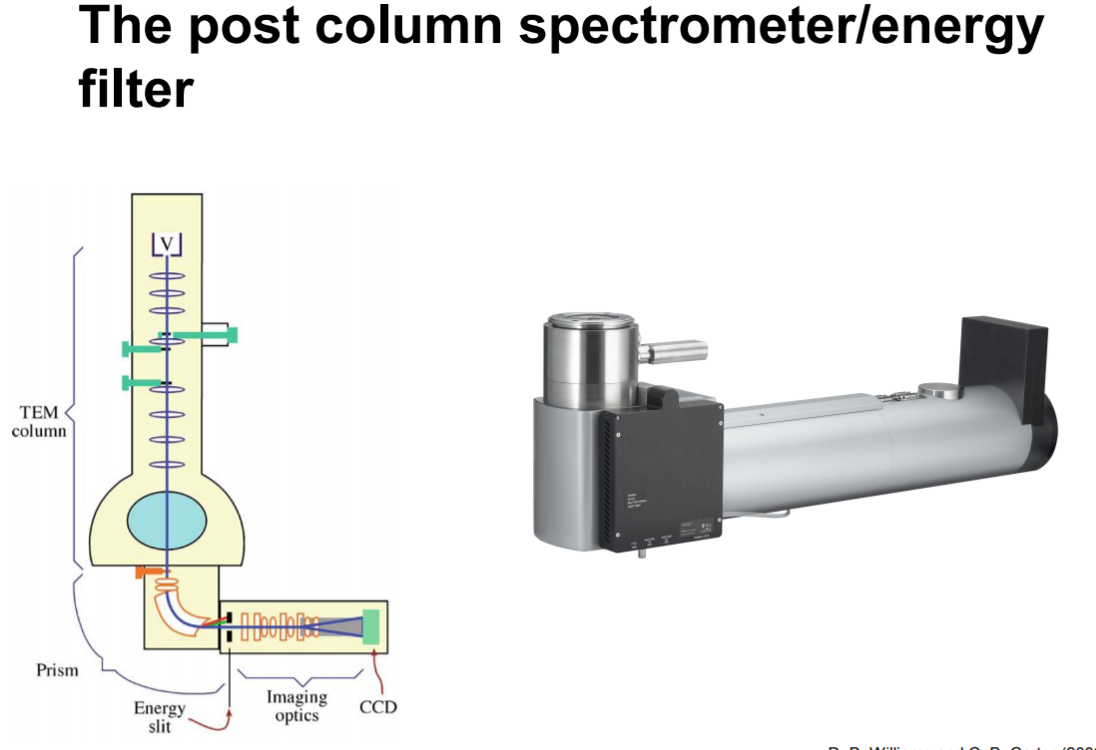
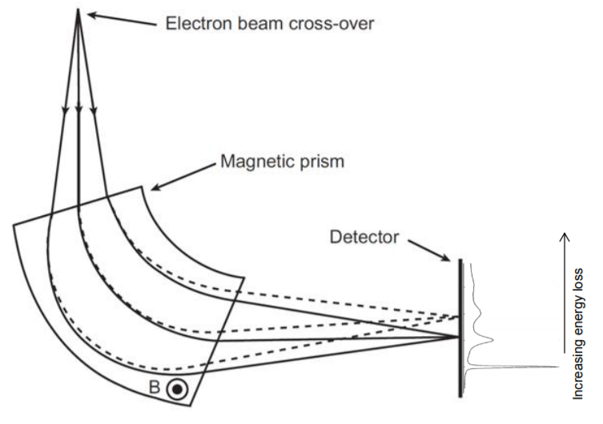

Slide 10
